Slide 1
Ch 11 Algebra Review
For sections 11.1 to 11.2

Slide 2
Given that “x” is equal to 7, what is the value of “x+12”
24
20
19
18
14

Slide 3
If “x+11” is equal to 33, what is the value of “x”?
44
22
3
24
23

Slide 4
Which of the following equations is(are) correct?

Slide 5
Which of the following equations is(are) correct?

Slide 6
Jack bought 2 startbucks coffee and a $2 banana loaf for $8. What does the variable “x” represent in the equation?
A) The total cost of the order
B) The number of times he ordered
C) The cost of two startbucks coffee
D) The cost of one starbucks coffee
E) How big the starbucks coffee was

Slide 7
A whole pizza has 8 slices and 3 slices cost $8.99. Which of the following equations is for the cost of one slice?

Slide 8
A whole pizza has 8 slices and 3 slices cost $8.99. Which of the following equations is for the cost of one whole pizza?

Slide 9
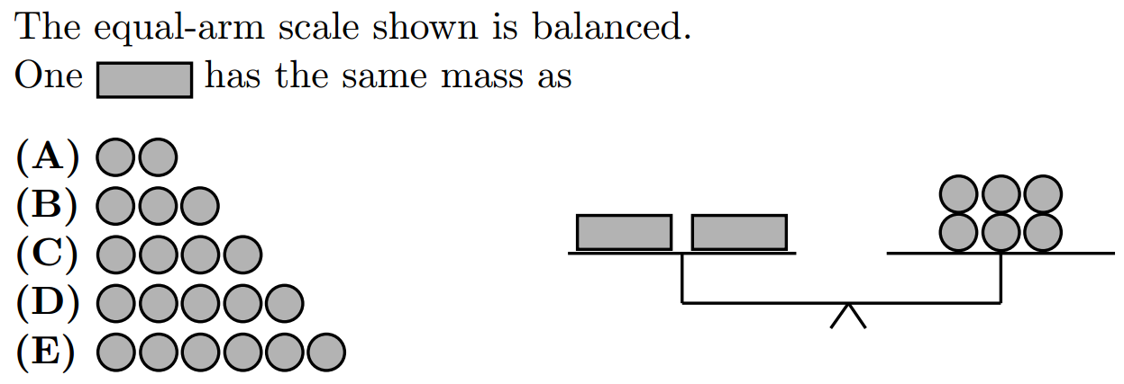

Slide 10
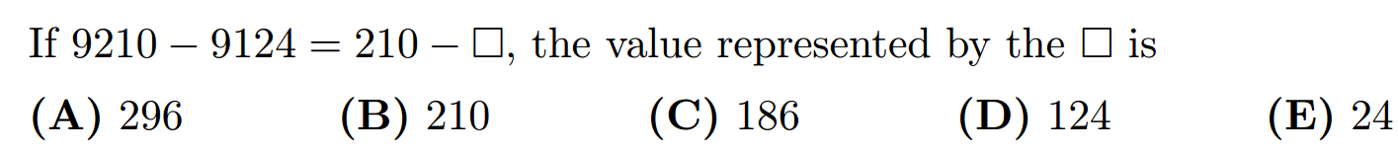

Slide 11
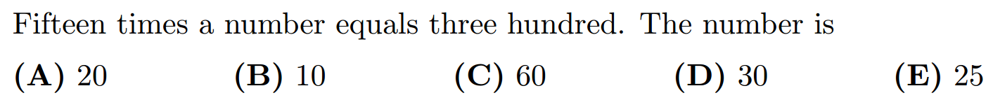

Slide 12
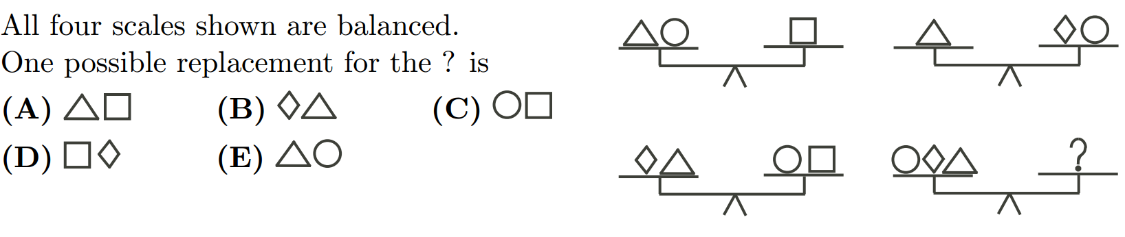

Slide 13
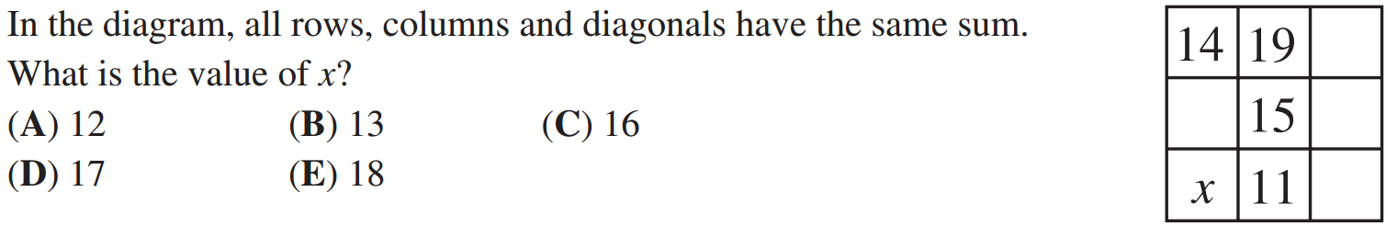

Slide 14
